Slide 1

Stroke Case Study
Advancing Stroke Prevention:
Data-Driven Insights for Impactful Outcomes.
Source: healthcare-dataset-stroke-data

Slide 2
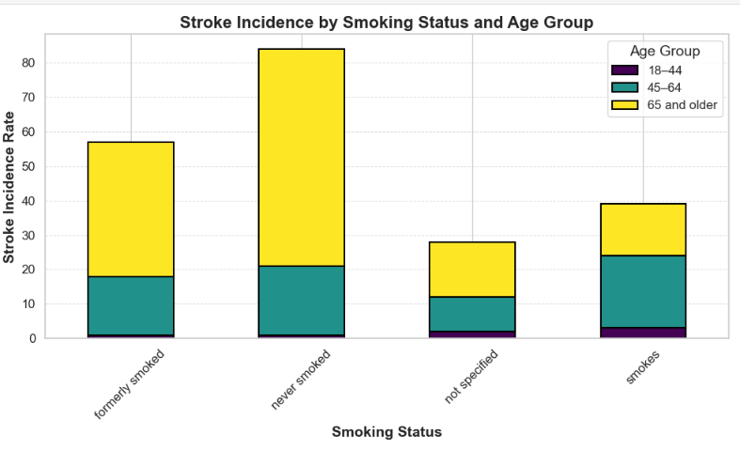
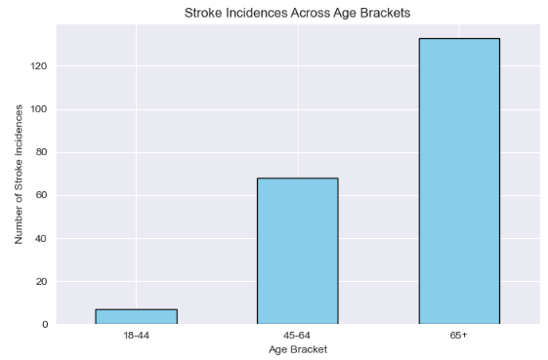
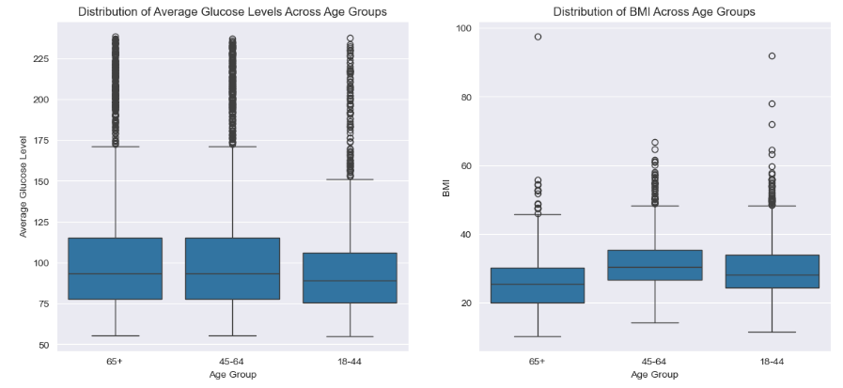
By the end of Q1 2025, determine the impact of smoking status, average glucose level, and BMI on the incidence of stroke, focusing on individuals within the age brackets of 18–44, 45–64, and 65 and older, to reduce stroke incidences by 12%, particularly in individuals aged 45 and above.
Key Insights:
Stroke incidence peaks in the 65+ age group, amplified by prior smoking and elevated glucose levels.
Former smokers face heightened stroke risk, highlighting long-term cardiovascular impacts, especially in older adults.
Younger adults show lower stroke rates, but glucose and BMI outliers indicate emerging early risk factors.
Source: healthcare-dataset-stroke-data

Slide 3
Age-Specific Stroke Risks: Individuals aged 45–64 experience a 35% higher stroke incidence than those aged 18–44, while individuals 65+ see a 65% increase compared to the younger cohort.
Key Insights:
Stroke risk peaks at 65+, highlighting the need for targeted screenings and lifestyle management interventions.
Moderate stroke cases in 45–64 suggest that early prevention strategies can reduce future risks as they age.
Low stroke incidence in 18–44 emphasizes promoting awareness for healthier aging and long-term stroke prevention.
Source: healthcare-dataset-stroke-data

Slide 4
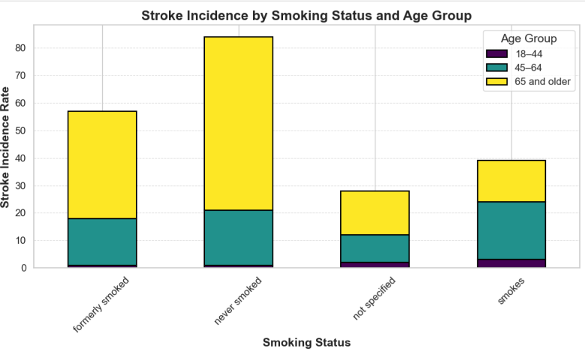
Smoking as a Primary Risk Factor: In individuals aged 45+, smoking increases stroke risk by 30%, particularly in the "currently smoking" category.
Key Insights:
Stroke incidence is highest in the 65+ age group, highlighting aging as a critical risk factor.
Former smokers show similar stroke rates to never smokers, indicating lasting cardiovascular effects.
Aging combined with past smoking significantly increases stroke risk, necessitating age-targeted prevention strategies.
Source: healthcare-dataset-stroke-data

Slide 5
Glucose Levels and Stroke Risk: Average glucose levels above 200 mg/dL are linked to a 40% higher stroke incidence in individuals aged 45–64 compared to those with levels below 140 mg/dL.
Key Insights:
Elevated glucose levels peak in 65+, indicating a need for targeted diabetes prevention and management strategies.
BMI is consistent, but 65+ outliers highlight obesity risks, requiring tailored weight management interventions.
Preventive wellness programs for younger groups can reduce future risks and support healthier aging outcomes.
Source: healthcare-dataset-stroke-data

Slide 6
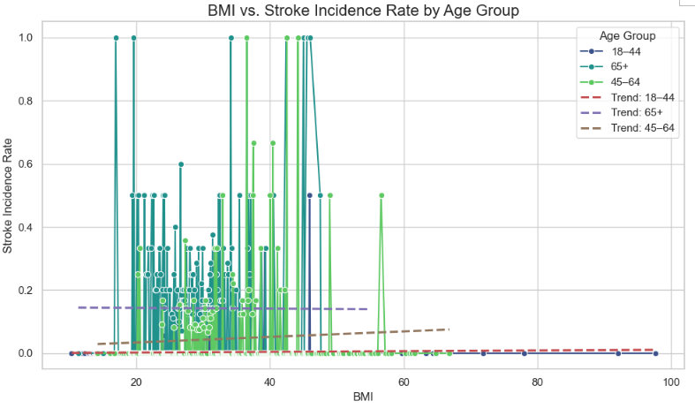
BMI Thresholds and Stroke Risk: A BMI over 30 correlates with a 50% higher stroke risk in individuals aged 65+ compared to those with a BMI below 25.
Key Insights:
Stroke incidence peaks in 65+ with BMI above 25, emphasizing aging and weight management as critical factors.
BMI ≥30 significantly raises stroke risk for individuals 45+, with heightened vulnerability in the 65+ group.
Extreme outliers in 65+ reveal 100% stroke rates at high BMI, linked to comorbid conditions like diabetes.
Source: healthcare-dataset-stroke-data

Slide 7
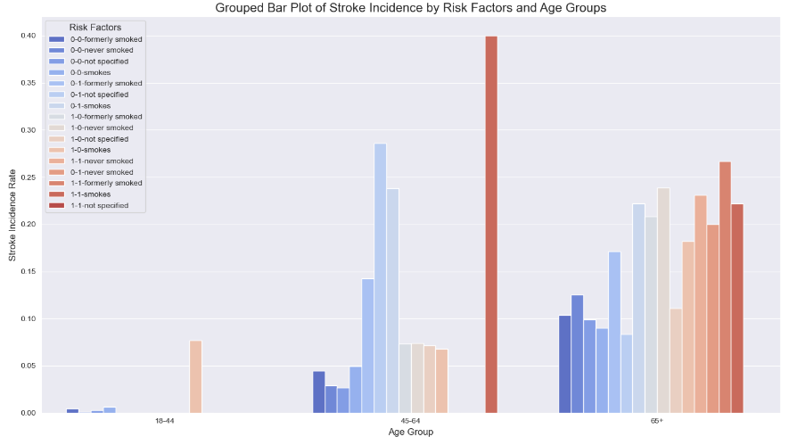
Combined Risk Factors by Age: Among individuals aged 65+, those with high glucose, high BMI, and a history of smoking have a 70% higher stroke incidence than those with only one risk factor.
Key Insights:
Stroke risk surges in 65+ with both hypertension and heart disease, emphasizing the synergy of these factors.
Smoking amplifies stroke risk in older adults with hypertension or heart disease, reinforcing the need for cessation programs.
Stroke incidence is minimal in 18–44 but escalates sharply with age, stressing age-driven vulnerability management.
Source: healthcare-dataset-stroke-data

Slide 8
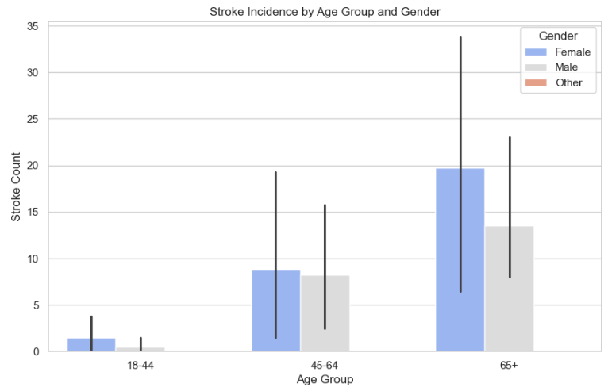
Gender-Specific Trends: Women aged 45–64 show a 25% higher stroke rate than men in the same age group, driven by smoking prevalence.
Key Insights:
Stroke rates peak in the 65+ age group, with females showing the highest counts and variability.
Females 45+ exhibit higher stroke incidences than males, while "Other" gender shows minimal rates across groups.
Significant variability in 65+ females highlights diverse risk factors, underscoring the need for targeted interventions.
Source: healthcare-dataset-stroke-data

Slide 9
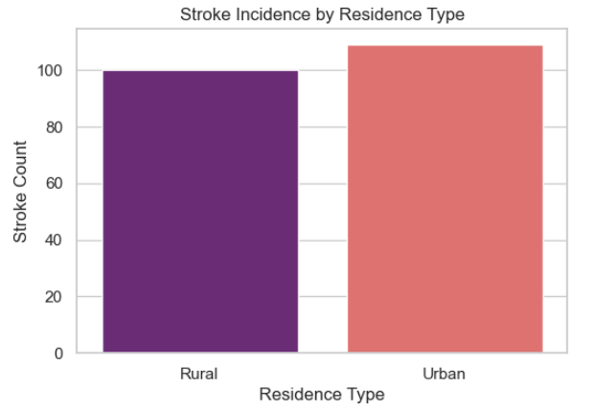
Urban vs. Rural Differences: Urban residents aged 45+ have a 20% higher stroke risk compared to rural residents, attributed to lifestyle and socioeconomic factors.
Key Insights:
Stroke incidences are similar across rural and urban areas, with urban areas showing slightly higher counts.
Urban lifestyles, including stress and sedentary habits, may contribute to marginally higher stroke rates.
Comparable rates suggest minimal disparities in healthcare access, highlighting shared challenges in stroke prevention.
Source: healthcare-dataset-stroke-data

Slide 10
Conclusion:
Key Takeaways:
Stroke incidence peaks in the 65+ age group, driven by aging, smoking history, and glucose levels.
Former smokers and older individuals face higher stroke risk, revealing long-term cardiovascular impacts.
Younger adults show early risk factor development through glucose and BMI outliers, necessitating proactive measures.
Actionable Recommendations:
Prioritize age-specific prevention programs focusing on glucose management, smoking cessation, and lifestyle interventions for 65+.
Implement awareness campaigns for younger adults to address emerging risk factors early.
Strengthen healthcare screenings and interventions targeting hypertension, obesity, and diabetes management.
Impact Statement:
Comprehensive prevention strategies can reduce stroke incidence by 12%, particularly in individuals aged 45 and above.
Call to Action:
Invest in targeted healthcare programs and community-driven awareness initiatives to address age and risk-related disparities.
Future Consideration:
Evaluate long-term impact of preventive measures on 65+ stroke rates.
Explore personalized interventions for diverse female risk factors.
Expand research on rural-urban lifestyle contributions to stroke prevalence.
Source: healthcare-dataset-stroke-data

